Slide 1
Jorge A. Garcia Galicia
Portfolio

Slide 2
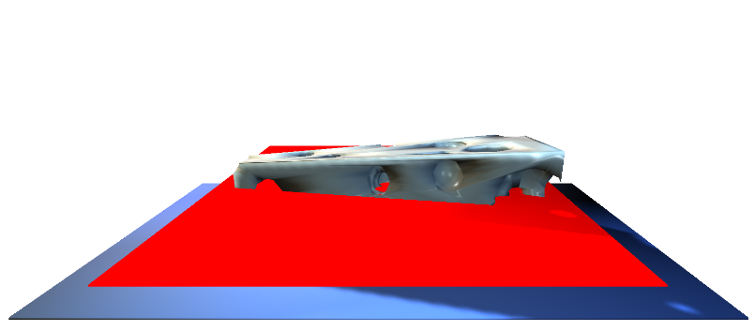

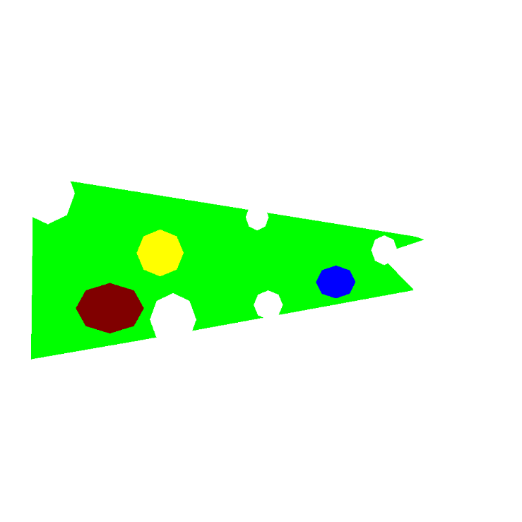
Slicing simulation for 3D printing
Develop a framework for simulate the slicing of a 3D mesh by planes.
The cut is represented by an image than is then analyzed and classified in contours.
Programming of geometrical tools in C++.
User interface in Qt.
Cheese model with holes.
Image of the cut
Final output

Slide 3
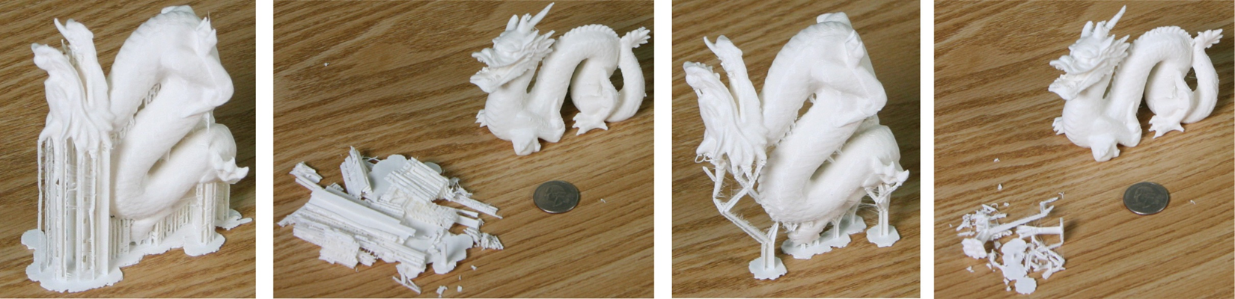
Cleaver supports for 3D printing
Created an algorithm for constructing the support structure needed for 3D printing.
Geometrical design of the support structure. Programming of a geometrical tool for ray to cone intersection.
Out of the box result
Algorithm improvement

Slide 4
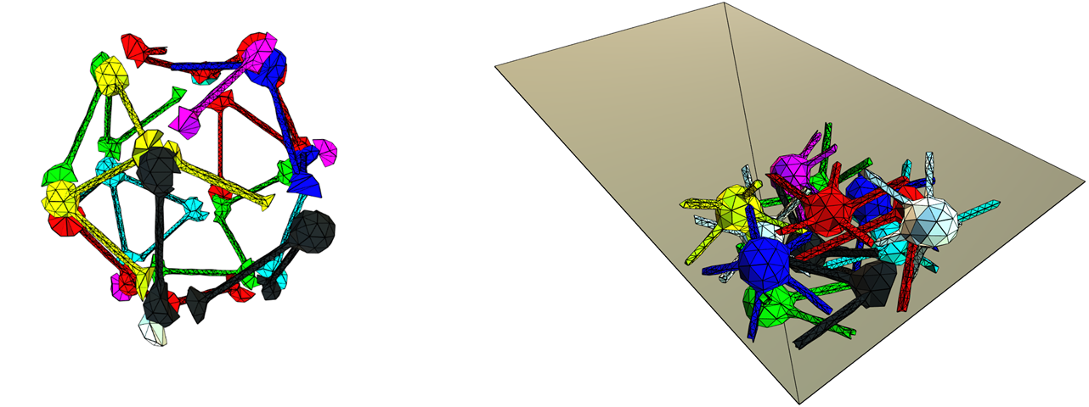
Bin packing for 3D printing
Designed a combinatorial optimization procedure for calculating optimal order of the pieces to be tightly packed for 3D printing.

Slide 5
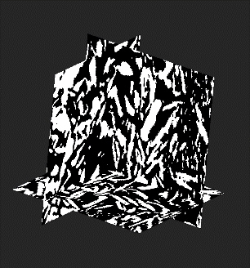
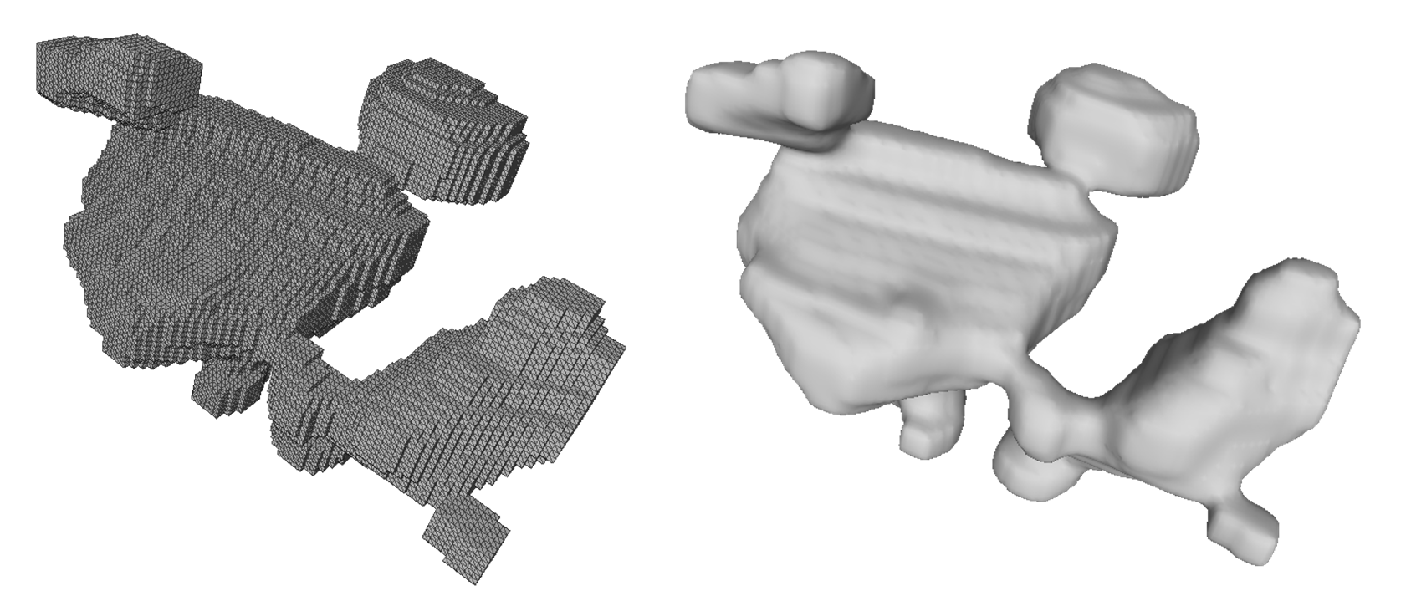
Visualization of internal structure of batteries
Visualization by orthogonal cuts of a 3D binary image.
Programming in C++ and OpenGL
Extracted connected components, and then smooth their surface for visualization.
Programming in C++, and created an *.obj exporter, created a scrip for smoothing and visualization in MeshLab.

Slide 6
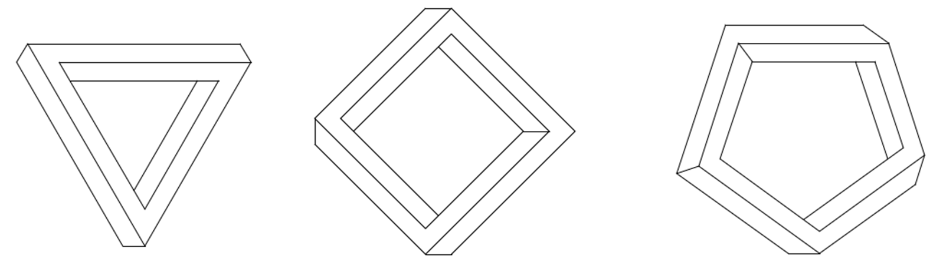
Impossible figures generator
Procedural generation of impossible figures using graph theory and braid theory.
Reinterpretation of Jose Yturralde’s wok.

Slide 7
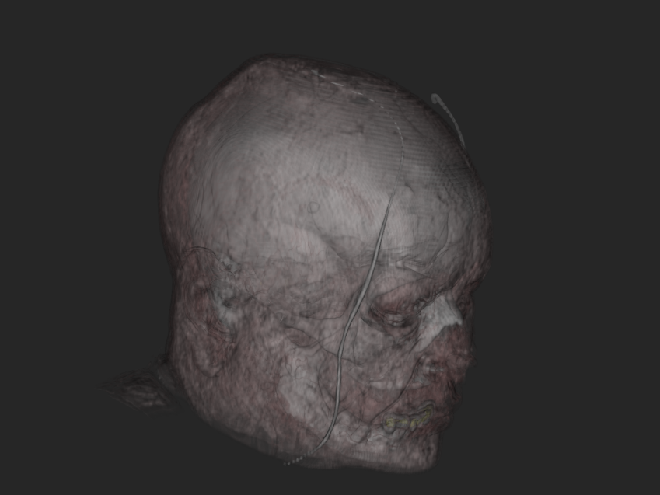
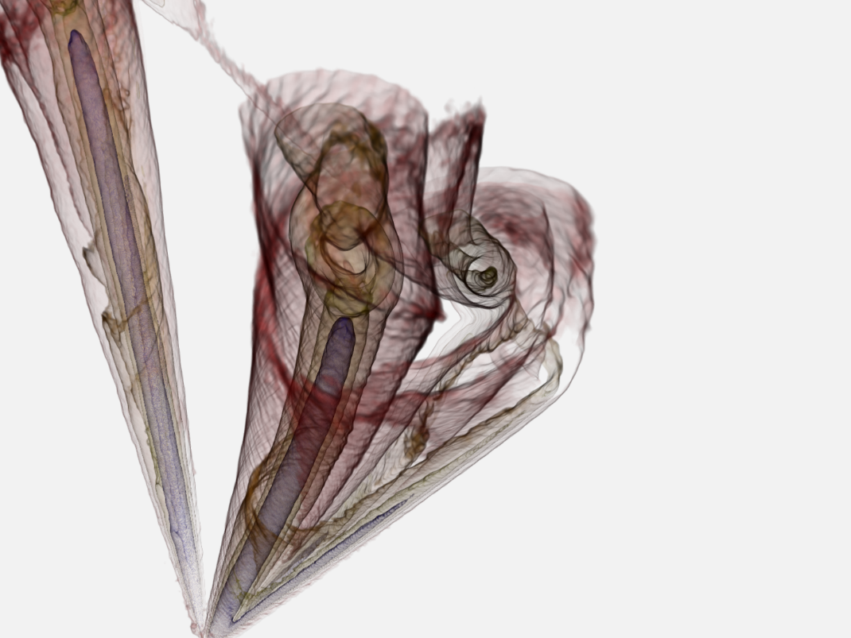
Volume renderer
Visualization of data using C++ and VTK.

Slide 8
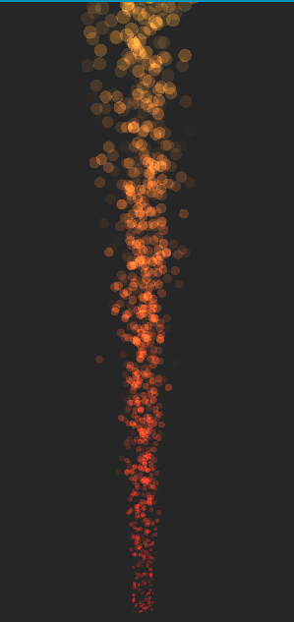
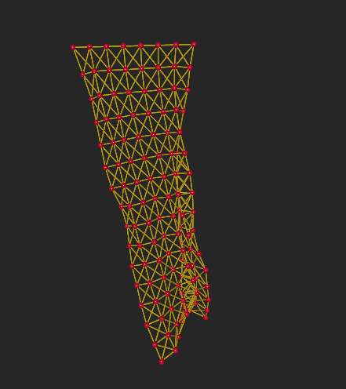
Particle simulations
Used mass-spring model to simulate a flag. And shader based billboard to simulate fire.
Programed using C++ and OpenGL on freeglut.

Slide 9
Jorge A. Garcia Galicia
Portfolio

